Slide 1
AI-Driven Crop Disease Prediction and Management System
CSE7101- Capstone Project
Review-2
Batch Number: ISE_23
Roll Number | Student Name
20221ISE0077 | HARSHITHA V
20221ISE0082 | TAANYA SUBBAIAH B
20221ISE0065 | M ASWIN
Under the Supervision of,
Dr. Murali Parameswaran
Professor
School of Computer Science and Engineering
Presidency University
Name of the Program: Information Science and Engineering
Name of the HoD: Dr. Zafar Ali Khan N
Name of the Program Project Coordinator: Ms. Suma N G
Name of the School Project Coordinators: Dr. Sampath A K , Dr. Geetha A

Slide 2
Content:
Abstract
Literature Survey
Objectives
Existing Methods and Drawbacks
Proposed Method & Feasibility Study
Block Diagram
Modules
Hardware/Software Requirements
Timeline
References

Slide 3
Abstract
Agriculture is one of the most important sectors contributing to food security, yet crop diseases continue to cause significant yield losses worldwide. Traditional disease detection relies on manual inspection, which is time-consuming, error-prone, and requires expert knowledge. To address this, we propose an AI-driven crop disease detection and management system using deep learning, specifically convolutional neural networks (CNNs). The system preprocesses leaf images, classifies them as healthy or diseased, and provides timely recommendations to farmers. This approach ensures early detection, reduces crop losses, and promotes sustainable agricultural practices.

Slide 4
Literature Survey:
Ref no. | Author(s) & Year | Approach / Method
[1] Mohanty et al., 2016 | CNN-based deep learning on PlantVillage dataset | Early use of CNNs for plant disease detection; achieved high accuracy but dataset limited to lab conditions.
[2] Too et al., 2019 | Fine-tuning deep learning models | Compared multiple pre-trained CNNs (e.g., VGG, ResNet); improved accuracy but required large compute resources.
[3] Ferentinos, 2018 | Deep CNN models for diagnosis | Trained CNNs on 58,000 images, achieved >99% accuracy; model less effective in real field conditions.
[4] Jiang et al., 2019 (IEEE Access) | Improved CNN for apple leaves | Real-time apple leaf disease detection; robust but crop-specific.

Slide 5
Literature Survey:
Ref no. | Author(s) & Year | Approach / Method
[5] Zhang et al., 2018 (IEEE Access) | CNN for maize leaf diseases | High accuracy on maize dataset; limited scalability to other crops.
[6] Yu & Son, 2020 (IEEE Access) | ROI-aware CNN | Focused on diseased regions in images; better precision but computationally heavy.
[7] Sladojevic et al., 2016 (IEEE IJCNN) | Applied CNNs for leaf image classification. | First use of deep learning in crop disease detection, achieved good accuracy; dataset small and limited to lab conditions.
[8] Amara et al., 2017 (IEEE AIPR) | CNN-based banana leaf disease classification. | Showed strong accuracy for banana diseases; limitation is crop-specific model and need for larger datasets.

Slide 6
Literature Survey:
Ref no. | Author(s) & Year | Approach / Method
[9] Li et al., 2021 (IEEE Access) | Review on deep learning in plant disease | Summarized advances in DL for agriculture; identified gaps in real-world deployment.
[10] Chen et al., 2021 (IEEE Access) | Improved CNN for tomato leaf diseases | Enhanced detection accuracy for tomato diseases; specific to one crop.

Slide 7
Objectives
Detect crop leaf diseases early using AI-driven methods.
Develop a reliable and accurate CNN-based classification model.
Provide farmers with actionable disease management recommendations.
Build a low-cost, user-friendly system (web/mobile).
Reduce yield loss and support sustainable agriculture.

Slide 8
Existing Methods and Drawbacks
Traditional plant disease detection has largely relied on manual inspection, which is labor-intensive, requires expert knowledge, and is prone to human error. Early machine learning approaches used handcrafted features with classifiers such as SVM or k-NN, but these methods struggled with accuracy and scalability across different crops. Some mobile applications now attempt disease identification, but they are limited to specific crop types and often fail in real-world conditions due to variations in lighting, background, and leaf appearance.
Drawbacks
Manual inspection - slow, costly, and error-prone.
ML models with handcrafted features - poor scalability.
Mobile apps - limited to few crops.
Low accuracy under real-world farm conditions .

Slide 9
Proposed Method & Feasibility Study
Proposed Method:
Input: Crop leaf image (via phone/camera).
Preprocessing: OpenCV (resize, normalize, augment).
CNN Model (TensorFlow)- classify disease.
Output: Disease type + Recommended treatment.
Feasibility Study:
Technology: Python, TensorFlow, OpenCV .
Cost: Low.
Scalability: Can extend to multiple crops and mobile app deployment.

Slide 10
Block Diagram:
Data Collection
-Crop Images
-Public datasets
Preprocessing
-Resizing
-Augmentation
-Noise removal
Disease Detection Mode
-CNN
-Feature Extraction
-Classification
Recommendation System
-Fertilizer/Pesticide Advice
-Preventive Measures
Output
-Healthy//Diseased Result
-Suggested Treatment

Slide 11
Modules:
Data Collection & Preprocessing - Gather leaf images, normalize, augment.
Disease Detection Model - CNN-based classification.
Recommendation Engine - Suggest treatments & fertilizers.
User Interface - Web/Mobile app for farmers.
Database - Store crop images, predictions, and results.

Slide 12
Hardware/Software Requirements:
Hardware:
Input Device: Smartphone/Camera.
Processing: Laptop/PC with GPU.
Software:
Programming: Python
Frameworks: TensorFlow
Libraries: OpenCV, NumPy, Pandas, Matplotlib
Version Control: GitHub

Slide 13
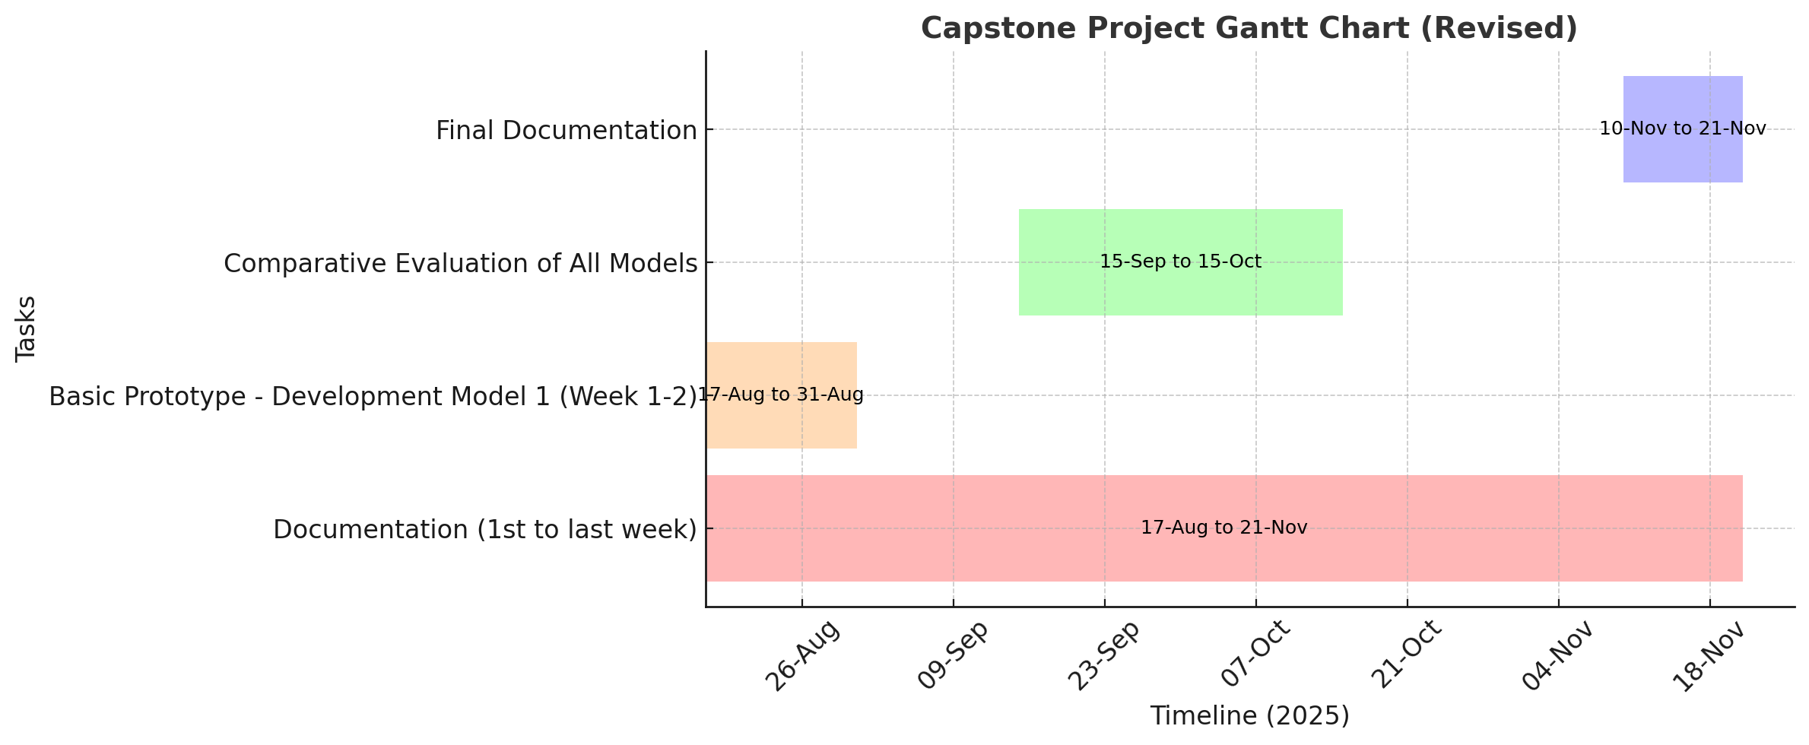
Timeline of the Project (Gantt Chart)

Slide 14
Github Link
Link- https://github.com/harshithahaa/AI-driven-Crop-Disease-Prediction-and-Management-System

Slide 15
References (IEEE Paper format)
[1]. S. Mohanty, D. Hughes, and M. Salathé, “Using deep learning for image-based plant disease detection,” Frontiers in Plant Science, vol. 7, p. 1419, Sep. 2016.
[2]. A. Too, L. Yujian, S. Njuki, and L. Yingchun, “A comparative study of fine-tuning deep learning models for plant disease identification,” Computers and Electronics in Agriculture, vol. 161, pp. 272–279, Jun. 2019.
[3]. P. Ferentinos, “Deep learning models for plant disease detection and diagnosis,” Computers and Electronics in Agriculture, vol. 145, pp. 311–318, Feb. 2018.
[4]. P. Jiang, Y. Chen, B. Liu, D. He and C. Liang, “Real-Time Detection of Apple Leaf Diseases Using Deep Learning Approach Based on Improved Convolutional Neural Networks,” IEEE Access, vol. 7, pp. 59069–59080, 2019.
[5]. X. Zhang, Y. Qiao, F. Meng, C. Fan and M. Zhang, “Identification of Maize Leaf Diseases Using Improved Deep Convolutional Neural Networks,” IEEE Access, vol. 6, pp. 30370–30377, 2018.

Slide 16
References (IEEE Paper format)
[6]. H.-J. Yu and C.-H. Son, “Apple Leaf Disease Identification through Region-of-Interest-Aware Deep Convolutional Neural Network,” IEEE Access, vol. 8, pp. 60696–60706, 2020,
[7]. S. Sladojevic, M. Arsenovic, A. Anderla, D. Culibrk and D. Stefanovic, “Deep Neural Networks Based Recognition of Plant Diseases by Leaf Image Classification,” IEEE International Conference on Neural Networks (IJCNN), pp. 3640–3647, 2016.
[8]. K. Amara, B. Bouaziz and A. Algergawy, “A Deep Learning-Based Approach for Banana Leaf Diseases Classification,” 2017 IEEE Applied Imagery Pattern Recognition Workshop (AIPR), pp. 1–6, 2017.
[9]. L. Li, S. Zhang and B. Wang, “Plant Disease Detection and Classification by Deep Learning—A Review,” IEEE Access, vol. 9, pp. 56683–56698, 2021.
[10]. J. Chen, W. Chen, B. Zhang, Z. Tao, Y. Wu and M. Han, “Detection of Tomato Leaf Disease Based on Improved Convolutional Neural Network,” IEEE Access, vol. 9, pp. 30812–30825, 2021.

Slide 17


